Slide 1
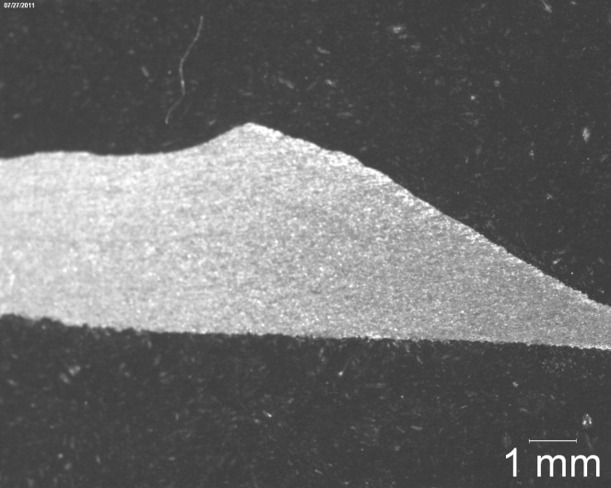
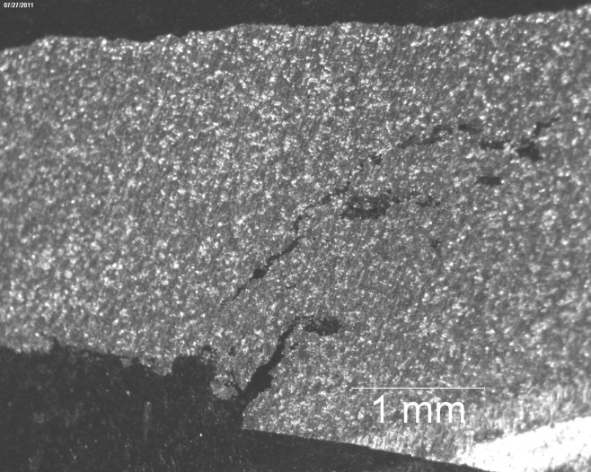
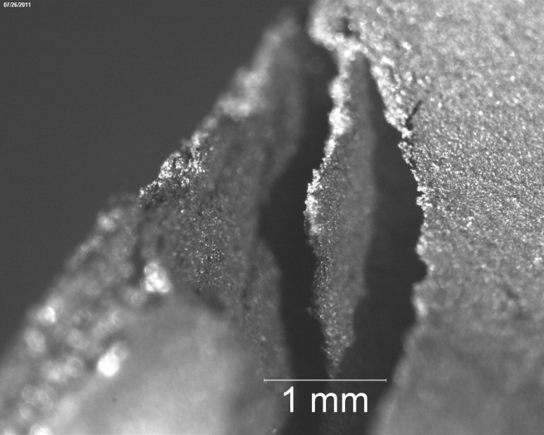
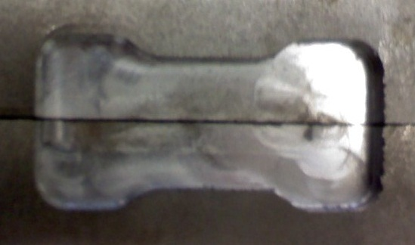
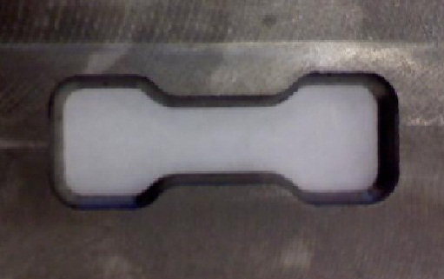
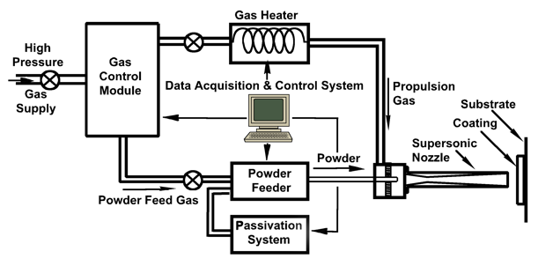
Mechanical Properties of Aluminum & Alumina by Cold Spray Process
Program Information
National Science Foundation’s
Research Experience for Undergraduates
Summer 2011 Grant #0852057
Authors
Ashleigh Giffen,
Myriah Santistevan
Faculty Advisors:
Dr. Michael West – REU Site Director
Dr. Bharat Jasthi – AMP Research Assistant
Dr. Alfred Boysen – Technical Communications
BACKGROUND
MATERIALS AND METHODS
RESULTS
Cold Spray Deposition
Discovered in mid-1980’s
Been used to repair or reinforce metals
Little known about mechanical properties of deposition itself
Al/Al203 Deposition
Research on thermal expansion of deposits by Erik Klinckman and team
Analysis of mechanical properties of the deposits has not been researched.
Materials
Al/Al203 Cold Spray Deposits courtesy of Erik Klinckman, and teammates Nathan Salden, and Owen Britton
Cast Iron Dog-Bone Mold
Equipment
Cold Spray Equipment
Vickers Microhardness Machine
Scanning Electron Microscope
Optical Microscope
Procedures
The authors collaborated with Erik Klinckman to evaluate the microstructure of Al/Al203 mixture with various weight ratios.
The authors provided Erik Klinckman with a dog bone mold made by Matthew Carriker. The purpose of this dog bone was to make a deposit and evaluate the tensile properties of a Al/Al203 deposition.
Due to the results of #2, the authors redesigned the dog bone. Refer to “Results #3”.
Deposition of Al/Al203 onto stainless steal foil substrate. Removed deposit from the substrate using CPT. Deposit cut into 4 pieces, mounted and studied. Refer to “Results #4”.
Evaluated 50/50 weight (Figure 2) & 10%Al/90%Al203 (Figure 3). Weight not equal to density. 50/50 is easily sprayed, 10/90 would be stronger but not efficient deposit.
Design of dog bone 1 (Figure 4) unsuccessful. When attempting to remove the dog bone, deposit crumbled. (Figure 9)
The authors have obtained new mold (Figure 5). Deposit is yet to be sprayed.
Performed microhardness testing (Figure 6) on solid sample (Figure 7) and on a cracked sample (Figure 8)
PURPOSE
Understand the microstructure and hardness of Al/Al203
Understand the Mechanical Properties of Al/Al203 Cold Spray deposit
Learn what treatments will effectively strengthen these properties and why
In doing this we will be able to better explain the importance of Cold Spray in the commercial world
Al Al2O3
Figure 6 Vicker’s Hardness Test
Figure 1
Figure 7
Figure 8
Figure 9
FUTURE RESEARCH
Figure 2 50/50 Al /Al203
Figure 3 90% Al203/10% Al
Figure 4 Dog Bone 1
Figure 5 Dog Bone 2
Acquire successful dog bone deposit to perform tensile testing
Anneal deposit to observe effects on mechanical properties
Friction Stir process deposit and observe effects on mechanical properties
ACKNOWLEDGMENTS
The authors would like to thank Dr. Michael West, Dr. Bharat Jasthi and Dr. Christian Widener (AMP Center Director) for their guidance throughout the project. We would like to thank Dr. Alfred Boysen for helping us to prepare our poster and paper. A special thanks goes to NSF for supporting us and our research.
http://www.ktech.com/Advanced_Manufacturing/Design_Build/Cold_Spray_System.html

